Slide 1
4.8: Newton’s Law and Half Life

Slide 2
An archaeological dig was conducted on the grounds of Methacton HS, where dinosaur remains were found, containing 1.67% of their original Carbon 14. If the half life of carbon 14 is 5600 years, what was the approximate age of the dinosaur?

Slide 4
5. A piece of coal is heated to 100°C and then is allowed to cool in a room whose air temperature is 30°C.
A. If the temperature of the coal is 80°C after 5 minutes, when will the temperature be 50°C?

Slide 5
5. A piece of coal is heated to 100°C and then is allowed to cool in a room whose air temperature is 30°C.
B. What is the temperature at 18.6 minutes?

Slide 6
5. A piece of coal is heated to 100°C and then is allowed to cool in a room whose air temperature is 30°C.
C. What is the elapsed time before the object reaches 35ºC?

Slide 7
5. A piece of coal is heated to 100°C and then is allowed to cool in a room whose air temperature is 30°C.
D. What do you notice about the temperature as the time passes?

Slide 8
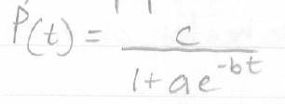
Logistical Model: Describes situations where the growth or decay of the dependent variable is limited (ex. Population growth)
In a logistic model, the population P, after time t obeys the equation:
Where a,b,&c are constants, with c > 0
Growth model: If b > 0
Decay model: If b < 0

Slide 10
6. Fruit flies are placed in a half-pink milk bottle with a banana (for food) and yeast plants (for food and to provide a stimulus to lay eggs). Suppose that the fruit fly populations after t days is:
A. State the carrying capacity and growth rate.
The carrying capacity is the numerator of the Logistic function, so the carrying capacity is 230.
The growth rate is the |b|, so the growth rate is |0.37|, which is 37%

Slide 11
6. Fruit flies are placed in a half-pink milk bottle with a banana (for food) and yeast plants (for food and to provide a stimulus to lay eggs). Suppose that the fruit fly populations after t days is:
B. Determine the initial population

Slide 12
6. Fruit flies are placed in a half-pink milk bottle with a banana (for food) and yeast plants (for food and to provide a stimulus to lay eggs). Suppose that the fruit fly populations after t days is:
C. What is the population after 5 days?

Slide 13
6. Fruit flies are placed in a half-pink milk bottle with a banana (for food) and yeast plants (for food and to provide a stimulus to lay eggs). Suppose that the fruit fly populations after t days is:
D. How long does it take for the population to reach 180?

Slide 14
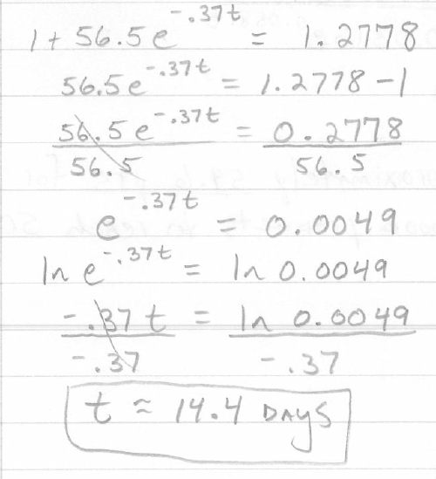

Slide 15
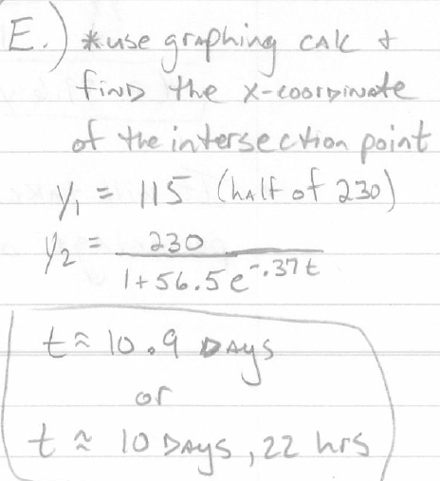
6. Fruit flies are placed in a half-pink milk bottle with a banana (for food) and yeast plants (for food and to provide a stimulus to lay eggs). Suppose that the fruit fly populations after t days is:
E. How long does it take for the population to reach
one-half of its carrying capacity?
Windows
X min 0 Ymin 0
X max 25 Ymax 250
X scl 5 Yscl 50

Slide 16
7. Wood products can be classified by their life span. The percentage of remaining wood products with long life spans after t years is given by:
A. What is the decay rate?
The decay rate is |b| = |-0.0581| = 5.81%

Slide 17
7. Wood products can be classified by their life span. The percentage of remaining wood products with long life spans after t years is given by:
B. What is the percentage of remaining wood products
after 10 years?

Slide 18
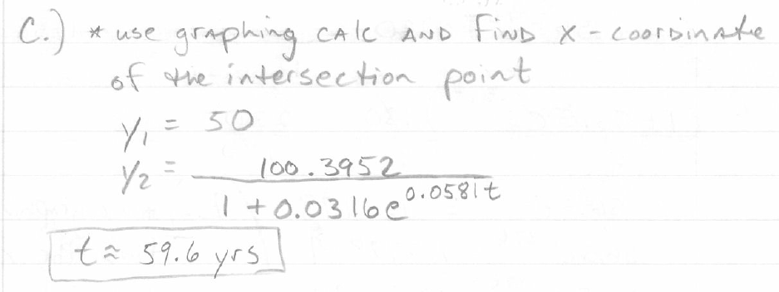
7. Wood products can be classified by their life span. The percentage of remaining wood products with long life spans after t years is given by:
C. How long does it take for the percentage of remaining
wood products to reach 50%?
Windows
xmin 0 Ymin 0
Xmax 150 Ymax 100
Xscl 30 Yscl 20

